Slide 1
The Congress of Graduate Students (COGS)

Slide 2
What is COGS & What Do We Do?
The Congress of Graduate Students (COGS) is the official representative body of graduate students at Florida State University. COGS is the part of student government dedicated to graduate students.
COGS Budget is allocated by SGA, each year we get 50% of graduate student A&S Fees (This has been increased in the last year, previously we were only receiving 30% of graduate A&S fees)
COGS Budget Historically:
2018-19: $567,200.00
2019-20: $562,400.00
2020-21: $580,000.00
2021-22: $609,000.00
2022-23: $1,265,303.00

Slide 3
COGS Spending
Three major categories of spending:
Funding for Registered Student Organizations (RSOs).
RSO funding is geared towards the organization of professional and/or cultural events across campus that aim to promote the professional development of FSU Graduate students, as well as the Diversity, Equity and Inclusion mission of the university.
Over 100 Graduate RSOs are funded!
COGS conference grants.
Attendance Grants: $150
Presentation Grants: $250 (National) $600 (International)
Other Big Ticket items: FSU Childcare ($300,000), Overhead ($180,000), SGA Salaries ($142,000), The Globe ($95,000)

Slide 4
COGS Historical Funding for RSOs
Funding Period | Funding
2018-19 | $110,000.00
2019-20 | $118,000.00
2020-21 | $130,000.00
2021-22 | $128,000.00
2022-23 | $220,000.00

Slide 5
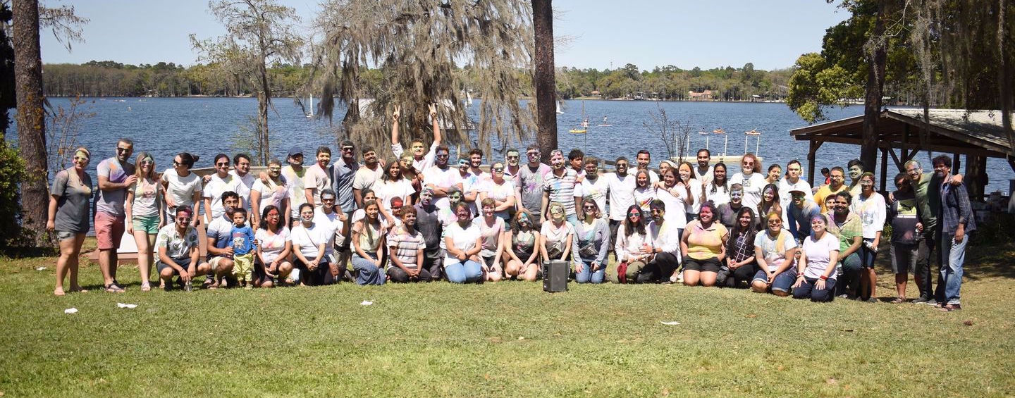
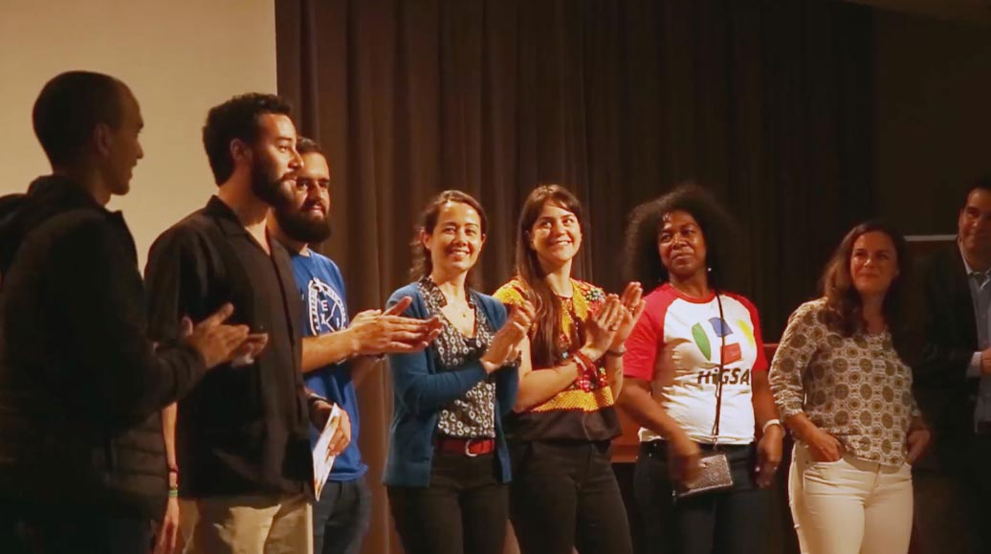
Examples of Events Funded for RSOs:
Past Events
Indian Student Association of Tallahassee (INSAT) Holi Event:
Estimated Attendance: 250
Lecture Series hosted by Counseling and School Psychology Students Helping to Advocate, Organize and Serve (CHAOS at FSU). :
Estimated Attendance: 30
Hispanic Graduate Student Association Cinnehassee Film Festival:
Estimated Attendance: 200 (over 4 films shown)
_{Slide xof x}

Slide 6
COGS Historical Funding for Conferences
Funding Period | Presentation | Attendance
2018-19 | $160,000.00 | $17,000
2019-20 | $160,000.00 | $17,000
2020-21 | $160,000.00 | $17,000
2021-22 | $160,000.00 | $17,000
2022-23 | $200,000.00 | $25,500
Funding/student/conference | 2021-22 (And prior) | 2022-23
Attendance Grant | $100 | $100
Presentation Grant (US) | $200 | $250
Presentation Grant (Int.) | $500 | $600

Slide 7
Conference Grants Utilization
During the 2021-22 funding period, 378 graduate students received Presentation grants (US and Int.) and 91 graduate students received Attendance grants.
So far, during the 2022-23 funding period, 172 graduate students have received Presentation grants (US and Int.) and 90 graduate students have received Attendance grants.
This is an increase of 300% for Presentation grants and 900% for Attendance grants, over the same time frame in the 2021-22 funding cycle.
This increase can be attributed to both the increase in funds and individual allocation and to increased mobility post-Covid.

Slide 8
Conference Costs
Conference registration fees can range from $100-200 to over $1,000.
This does not include travel and lodging.
A single conference for a single graduate student can cost as high as $3,000
Sources of funding: COGS, Departments, Mentor and self funding.
The utilization percentage of those funding sources greatly varies across departments and is directly tied to the funding of the departments and the mentor.

Slide 9
Main Concerns for Graduate Students
Retention: Do students have the support they need from the moment they enter to university? Some do, some don’t
International Student Concerns: initial housing for their family
TA Concerns
TAs are not students, but they are not faculty, don’t have as much support as faculty
Money
Stipends, Fees, Health Insurance costs
Costs for Research
Work-Research balance – balancing TA or other work while completing research
Conference costs

Slide 10
Thank You
Questions?

